Slide 1
Recommendation System
Hunter
4.30.2023

Slide 2
Agenda
What is a recommendation system?
Recommendation algorithms
Evaluation
Cold start
Streaming service

Slide 3
What is Recommendation System?
Wikipedia: A subclass of information filtering system that seeks to predict the "rating" or "preference" a user would give to an item
Use cases:
Netflix recommends movies (80% of all content)
Amazon recommends books ($98 billion of annual revenue)
Facebook recommends friends
Similar but NOT recommendations: price suggestion, name suggestion, search terms auto completion

Slide 4
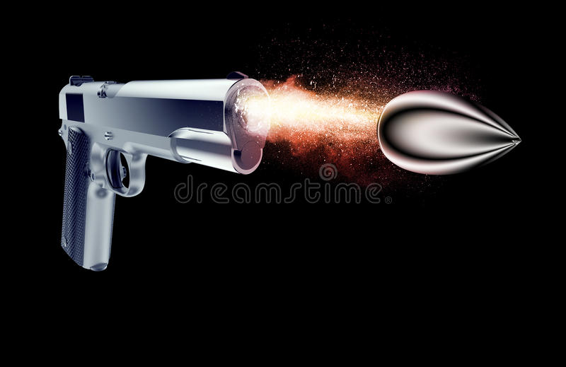
Recommendation System
Infrastructure – Gun: Data pipeline, Cluster, Spark, etc.
Recommendation Algorithm – Bullet

Slide 5
Recommendation Algorithms
Rule based: popularity, revenue, up-coming, new arrival,
Statistics based: association rule, RCP/ATD/MPG, seasonal top picks, trending now
Memory based: item-item filtering, user-user filtering
Model based: content-based filtering, collaborative filtering
Advanced: deep learning, reinforce learning.

Slide 6
Rule Based
Popularity (best seller/most view): recommend product has the most transaction or clicks.
Revenue: recommend product has the highest revenue.
Up-coming: sort by available time, status is unavailable.
New arrival: sort by available time, status is available.

Slide 7
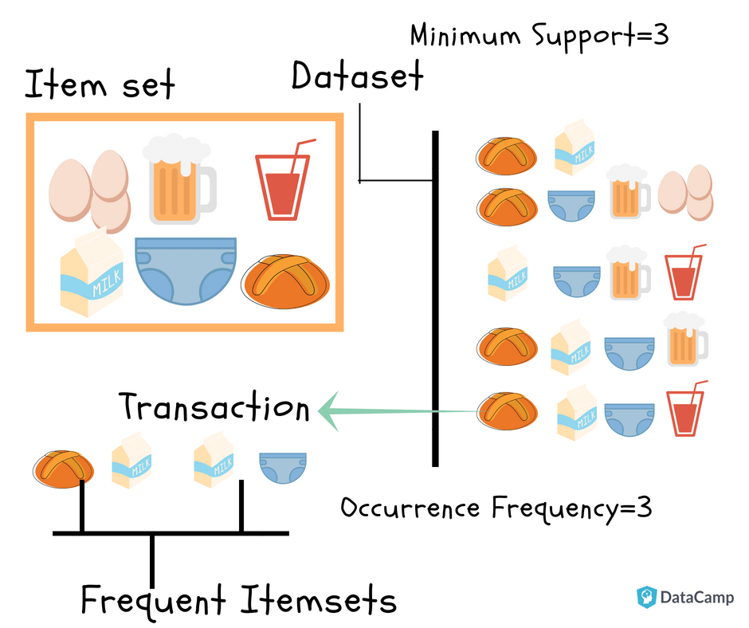
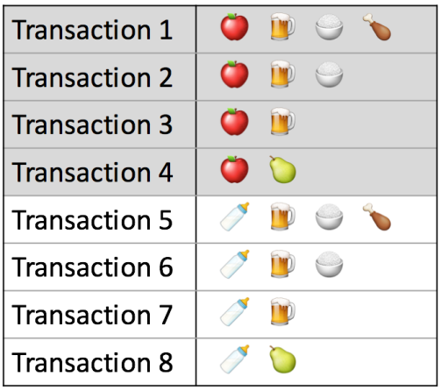
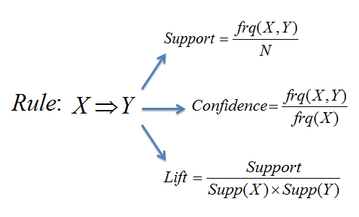


Statistics Based
Purchase-together: association rule
Packages: apyori, pyspark.ml.fpm.FPGrowth
50%
75%
100%

Slide 8


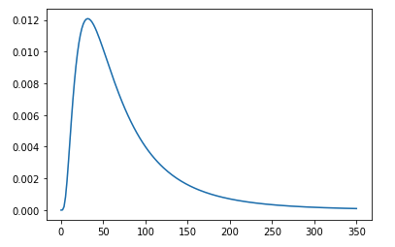
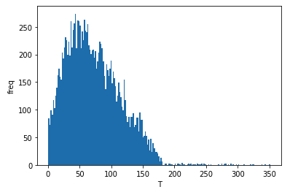
Statistics Based
But it again:
Repeat Customer Probability (RCP)
Aggregate Time Distribution (ATD)/Modified Poisson-Gamma (MPG): stats.lognorm/gamma
Performance: ATD = MPG > RCP
User A
Last purchased at 12/30/2019
Not Recommend
Log in website On 2020/1/1
User B
Last purchased at 11/20/2019
Recommend

Slide 9
Statistics Based
Seasonal top picks
Trending now

Slide 10
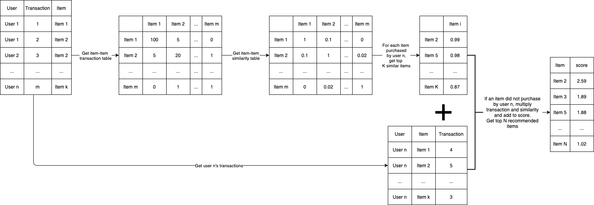
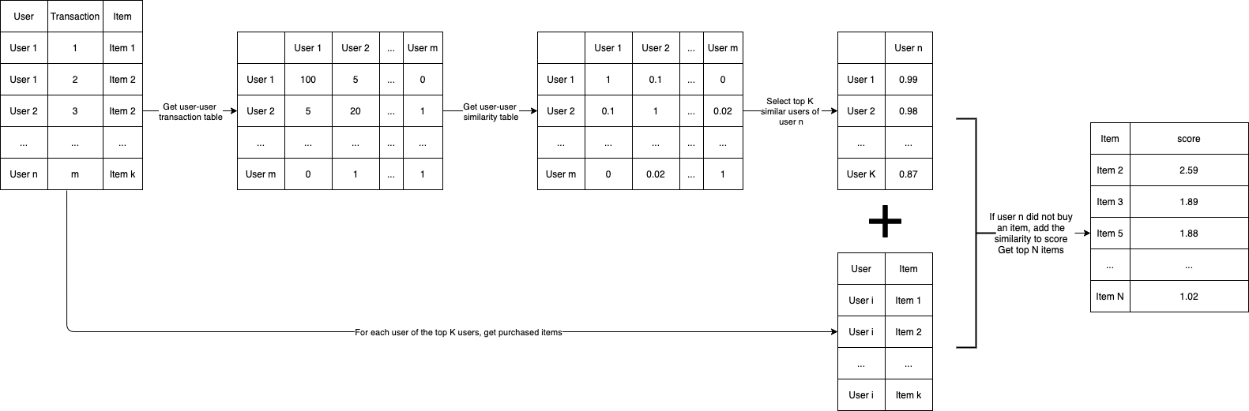
Memory Based
Item-item similarity filtering:
User-user similarity filtering:

Slide 11
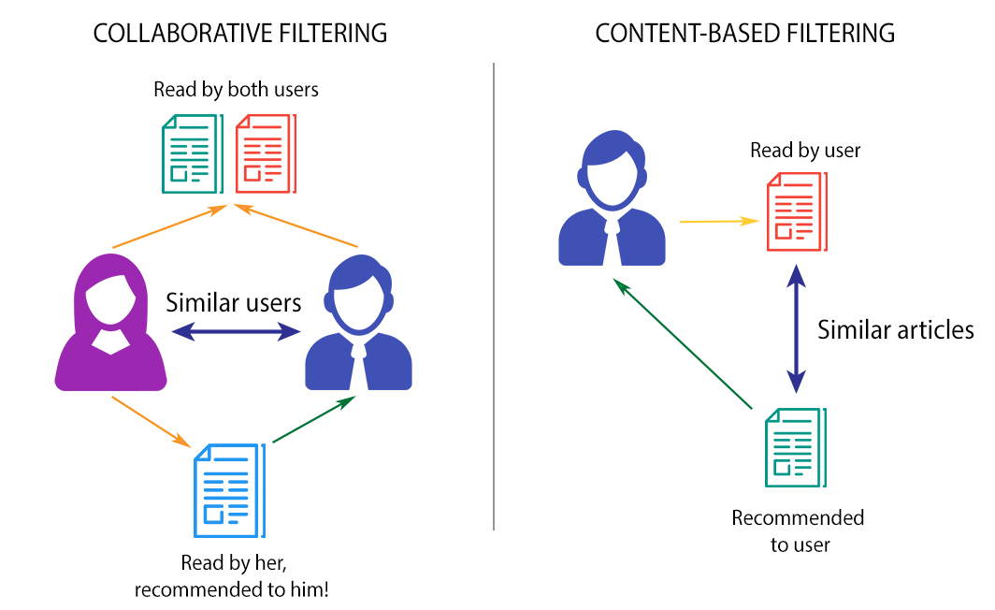
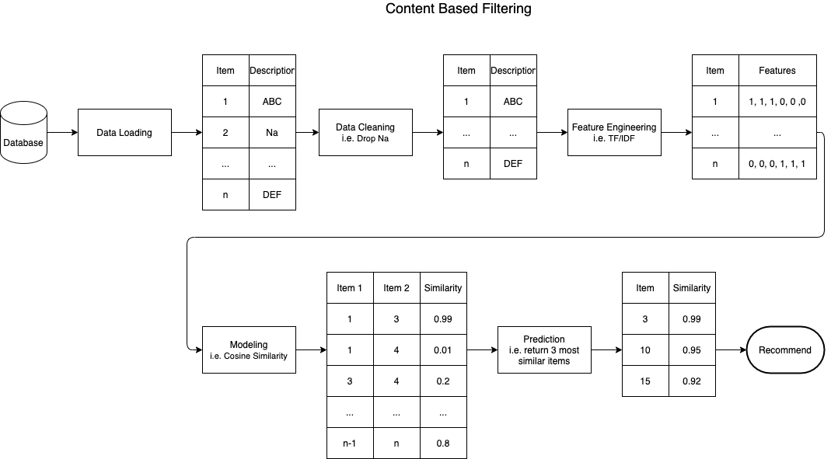
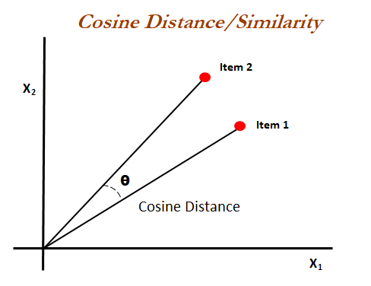
Model Based
Content-based filtering:
Word counter, TF/IDF, word-embedding
Cosine similarity (sklearn.metrics.pairwise.cosine_similarity)

Slide 12
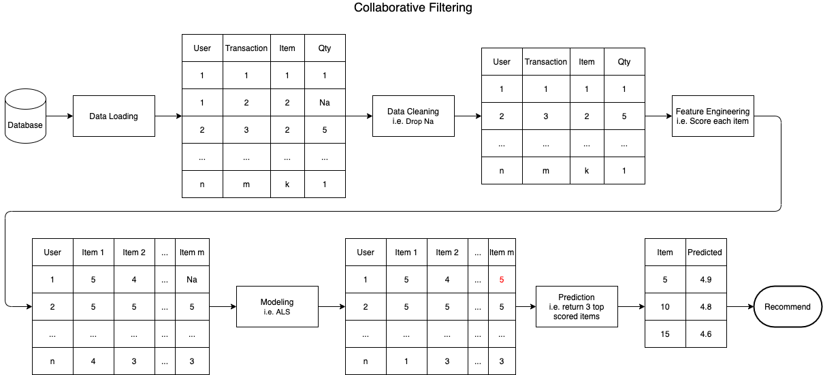
Model Based
Collaborative filtering:
Item-item similarity filtering:
User-user similarity filtering:
Matrix factorization:
ALS (pyspark.ml.recommendation.ALS)
SVG (surprise.SVD)

Slide 13
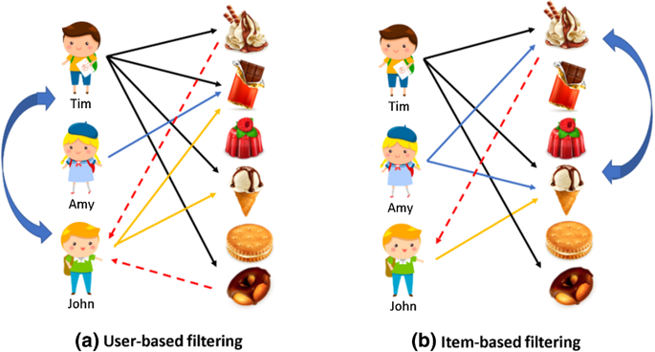
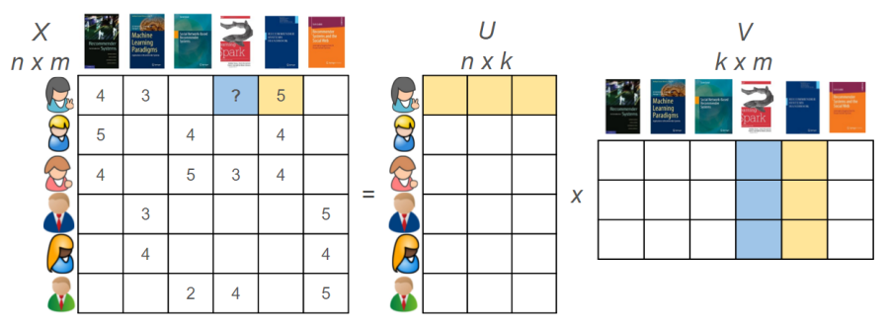
Matrix Factorization

Slide 14
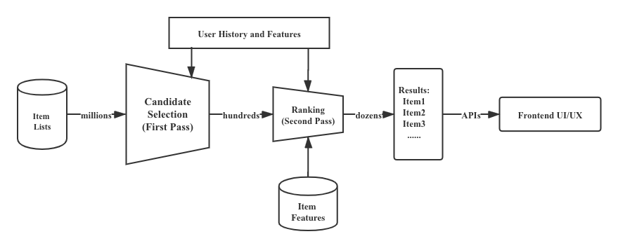
Advanced
Deep learning:
User embedding
Item embedding
Sequential data or average embedding
Recall (candidate selection): a multi-classification model
Ranking: a classification model

Slide 15
Evaluation
Offline evaluation: compare recommendations with actual purchased or clicked data
Precision/Recall/F1
ROC-AUC
Mean Average Precision (MAP)
Coverage: # of recommended items over # of all items
Diversity: get similarity between each pair of recommended items
Novelty: recommended item has been purchased before or not
Online evaluation:
Click through rate: how many recommended items have been clicked.
Conversion rate: how many recommended items have been purchased.
Revenue: How much revenue from purchased recommended items.

Slide 16
Cold Start
New products: no user behavior data, can use content-based filtering
New users: no behavior data, can use demographic data to identify similar users
New system: no data, can use external data to identify similar products

Slide 17
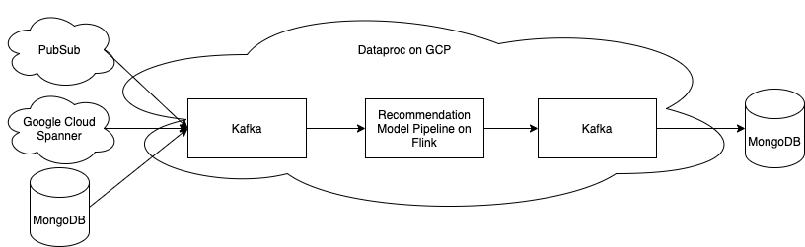
Streaming Service
Message queue: Kafka
Streaming model: Spark streaming, Flink

Slide 18
References
https://www.kdnuggets.com/2016/04/association-rules-apriori-algorithm-tutorial.html
https://assets.amazon.science/40/e5/89556a6341eaa3d7dacc074ff24d/buy-it-again-modeling-repeat-purchase-recommendations.pdf
http://sdsawtelle.github.io/blog/output/mean-average-precision-MAP-for-recommender-systems.html#MAP-for-Recommender-Algorithms
https://static.googleusercontent.com/media/research.google.com/en//pubs/archive/45530.pdf
http://www.cs.ucl.ac.uk/fileadmin/UCL-CS/research/Research_Notes/RN_11_21.pdf

